Slide 1
DataBase

Slide 2
DataBase Programming
methods that have been developed
for accessing databases from programs

Slide 3
Web Database
Programming
using PHP / Python

Slide 4
DataBase Programming
methods that have been developed
for accessing databases from Web Internet

Slide 5
Web Database
Programming
using PHP

Slide 6
why php
1995 – 2025 + top 3 or top 5 programming language
no – nonsense

Slide 7
PHP has seen a decline in popularity for several reasons:
  competition from other languages: Languages like JavaScript (especially with Node.js), Python, and Ruby have gained traction for web development
    these languages often offer modern features, frameworks, and a more developer-friendly syntax
PHP is still the most used server-side language on the internet by a very large margin
PHP is a general-purpose scripting language geared towards web development. It was originally created by Danish-Canadian programmer Rasmus Lerdorf in 1993 and released in 1995
PHP – Wikipedia https://en.wikipedia.org/wiki/PHP

Slide 8
C and Java programming languages …
many Internet applications that provide Web interfaces to access information stored in one or more databases use scripting languages
these script languages are often used to generate HTML documents, which are then displayed by the Web browser for interaction with the user

Slide 9
HTML is useful for generating static Web pages with fixed text and other objects
many Internet applications require Web pages that provide interactive features with the user
such Web pages, where part of the information is extracted from databases or other data sources, are called dynamic Web pages

Slide 10

there are various techniques for programming dynamic features into Web pages
PHP https://www.php.net/ open source, server-side scripting language
PHP stands for PHP Hypertext Processor
PHP has experienced widespread use
interpreters for PHP are provided free of charge and are written in the C language (C is written in assembler language and almost every other programming language, including PHP is written in C)
PHP is available on most computer platforms: Linux, MacOS, Windows, …

Slide 11
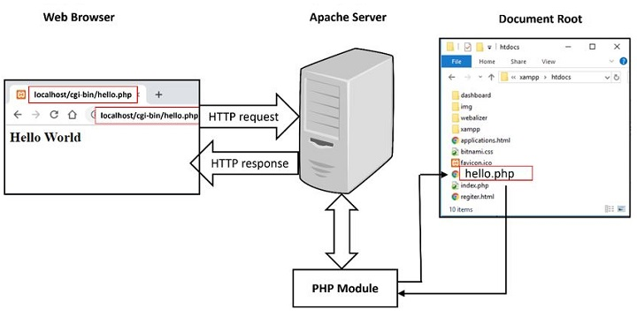

Slide 12
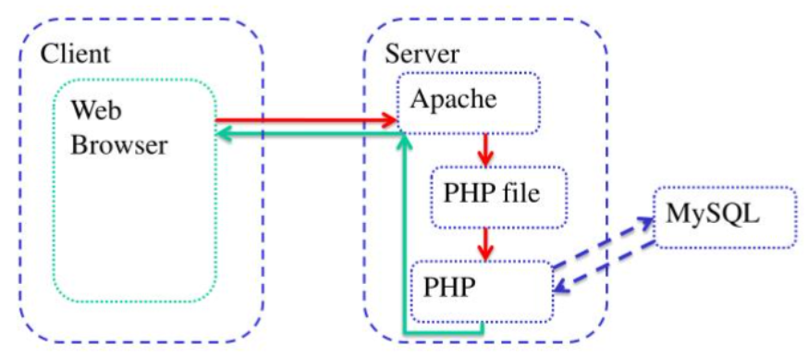

Slide 13
PHP executed on the server - server-side scripting programming language
JavaScript executed on the client, on the Web pages – client-side scripting programming language

Slide 14
Java Technologies for Database Web Programming
Java Servlets - are Java objects that can reside on Web server machine and manage interactions with the client; can store information that was submitted by client during a session, can generate database queries, can store query results, can format all these as HTML and sent to client for display
Java Server Pages (JSP) - allows scripting at the server to produce dynamic Web pages to be sent at the client; associated with Java language and scripting can be combined with Java code

Slide 15
ColdFusion
ColdFusion refers to Adobe's application server and server-side scripting language, CFML ColdFusion Markup Language, designed for rapid web application development RAD Rapid Application Development
allows developers to create dynamic web pages, connect to databases, and integrate with other systems
Lucee :: Accelerate your development with Lucee https://www.lucee.org/

Slide 16
ASP.NET open-source web development framework https://dotnet.microsoft.com/en-us/apps/aspnet
ASP.NET is a server-side web-application framework designed for web development to produce dynamic web pages
developed by Microsoft to allow programmers to build dynamic web sites, applications and services
name stands for Active Server Pages
name stands for Active Server Pages Network Enabled Technologies

Slide 17
PHP is an open source general-purpose scripting language
PHP interpreter can be downloaded and installed from: www.php.net
Composer https://getcomposer.org/ is a tool for dependency management in PHP; allows you to declare libraries your project depends on, and it will manage (install/update) them for you
  strongly inspired by node's npm and ruby's bundler

Slide 18
PHP has libraries of functions for accessing databases stored under various types of relational database systems such as Oracle, MySQL, SQLServer, PostGreSQL and any system that supports the ODBC standard
DBMS would reside at the bottom-tier database server.
PHP would run at the middle-tier Web server, where PHP program commands would manipulate HTML files to create customized dynamic Web pages
HTML is then sent to the client tier for display and interaction with the user

Slide 20
0) <?php
1) // Printing a welcome message if the user submitted their name
// through the HTML form
2) if ($_POST['user_name']) {
3) print("Welcome, ") ;
4) print($_POST['user_name']);
5) }
6) else {
7) // Printing the form to enter the user name since no name has
// been entered yet
8) print <<<_HTML_
9) <FORM method="post" action="$_SERVER['PHP_SELF']">
10) Enter your name: <input type="text" name="user_name">
11) <BR/>
12) <INPUT type="submit" value="SUBMIT NAME">
13) </FORM>
14) _HTML_;
15) }
16) ?>

Slide 21
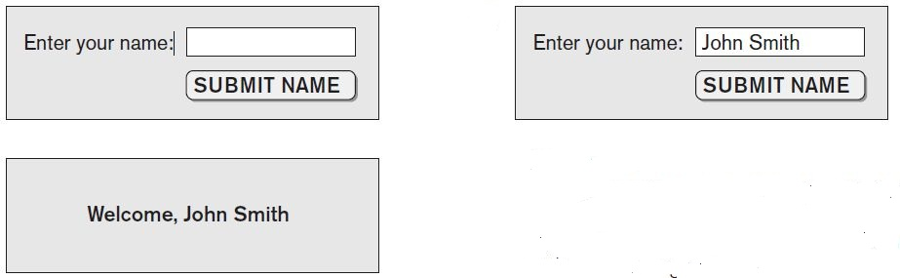

Slide 22
line 0 shows the PHP start tag <?php, which indicates that it should process all subsequent text lines until it encounters the PHP end tag ?>, shown on line 16
text outside of these tags is printed as is
this allows PHP code segments to be included within HTML file - only sections between <?php and ?> are processed by PHP interpretor

Slide 23
line 1 shows one way of posting comments in PHP program on a single line started by //
single-line comments can also be started with #, and end at the end of the line in which they are entered
multiple-line comments start with /* and end with */

Slide 24
the auto-global predefined PHP variable $_POST is an array that holds all the values entered through form parameters
when the Web page at http://www.myserver.com/example.php is first opened - file:///C:/.../example.php - php programs run on some Web server - the if condition in line 2 will evaluate to false because there is no value yet in $_POST['user_name’]
hence, PHP interpreter will process lines 6 through 15, which create the text for an HTML file that displays the form shown next ; which then displayed at client side by Web browser

Slide 25
line 8 shows one way of creating long text strings in an HTML file
all text between an opening <<<_HTML_ and a closing _HTML_; is printed into HTML file as it is
closing _HTML_; must be alone on separate line

Slide 26
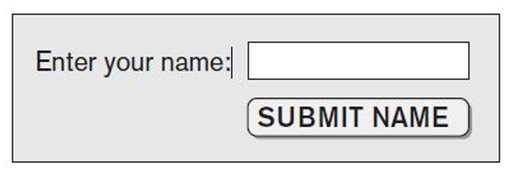

Slide 27
PHP variable names start with a $ sign and can include characters, numbers, and the underscore character _
the PHP auto-global (predefined) variable $_SERVER is an array that includes information about the local server
the action attribute of the form tag in line 9 instructs the PHP interpreter to reprocess the same file, once the form parameters are entered by the user
once the user types the name John Smith in the text box and clicks on the SUBMIT NAME button …

Slide 28
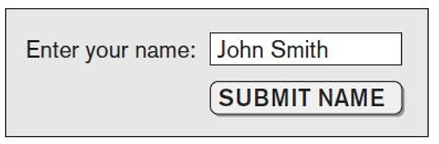

Slide 29
once the user types the name John Smith in the text box and clicks on the SUBMIT NAME button program segment is reprocessed
this time, $_POST['user_name'] will include the string "John Smith", so lines 3 and 4 will now be placed in the HTML file sent to the client which displays the message

Slide 30
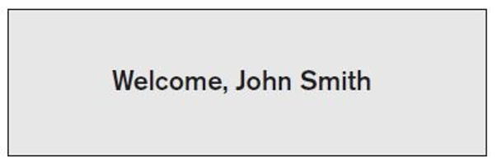

Slide 31
PHP Variables, Data Types, and Programming Constructs

Slide 32
Variables
variable names start with the $ symbol and can include characters, letters, and the underscore character (_)
variable names are case sensitive
variables are not typed, the values assigned to variables determine their type; the same variable can change its type once a new value is assigned to it
variable assignment is via the = operator

Slide 33
3 ways to express strings and text:
single-quoted strings – 'enclose string between single quotes' and not curly quotes ‘enclose string between single quotes’
if single quote is needed within the string, use escape character(\)
double-quoted strings – "enclose string between double quotes" and not curly quotes “enclose string between single quotes”
in this case, variable names appearing within the string are replaced by the values that are currently stored in these variables; interpreter identifies variable names within double-quoted strings by their initial character $ and replaces them with the value in the variable
known as interpolating variables within strings
interpolation does not occur in single-quoted strings

Slide 34
single and double quotes used by PHP to enclose strings should be straight quotes (' '), (" ") on both sides of string; text editor that creates these quotes should not produce curly opening and closing quotes (‘ ’), (“ ”) around the string

Slide 35
3 ways to express strings and text:
here document: enclose a part of a document between a <<<DOCNAME and end it with a single line containing document name
DOCNAME.
DOCNAME can be any string as long as it used both to start and end the here document
variables are also interpolated by replacing them with their string values if they appear inside here documents

Slide 36
use single-quoted strings for literal strings that contain no PHP program variables and the other two types when the values from variables need to be interpolated into the string

Slide 37
PHP also has numeric data types for integers and floating points

Slide 38
in PHP programming language there are standard programming language constructs of for-loops, while-loops, and conditional if-statements
generally, similar to their C language counterparts

Slide 39
any value evaluates to true if used as a Boolean expression except for numeric zero (0) and blank string, which evaluate to false
there are also literal true and false values that can be assigned

Slide 40
comparison operators also generally follow C language rules
they are == (equal), != (not equal), > (greater than), >= (greater than or equal), < (less than), and <= (less than or equal)

Slide 41
PHP Arrays
presented separately because of database

Slide 42
PHP Arrays
allow lists of elements, used frequently in forms
single-dimensional array is used to hold the list of choices in pull-down menu
two-dimensional arrays are used for database query results, with the first dimension representing rows of a table and the second dimension representing columns (attributes) within a row

Slide 43
two main types of arrays: numeric and associative
numeric - associates a numeric index with each element in the array; indexes are integer numbers that start at zero and grow incrementally
associative - provides pairs of (key => value) elements; value of element is referenced through its key, and all key values in array must be unique; element values can be strings or integers, or they can be arrays themselves, thus leading to higher dimensional arrays

Slide 44
techniques for looping through arrays
$teaching = array('Database' => 'Cenan', 'OS' => 'Colesa', 'Graphics' => 'Gorgan');
$teaching['Graphics'] = 'Stefanut'; $teaching['Data Mining'] = 'Potolea';
sort($teaching);
foreach ($teaching as $key => $value) {
print " $key : $value\n";}
for ($i = 0, $num = count($teaching); i < $num; $i++) {

Slide 45
PHP Functions

Slide 46
PHP Server Variables and Forms
$_SERVER['SERVER_NAME'] - provides the Web site name or the Uniform Resource Locator (URL) of the server where PHP is running
$_SERVER['REMOTE_ADDRESS'] - IP (Internet Protocol) address of client user computer that is accessing the server
$_SERVER['PATH_INFO'] - part of URL address that comes after a backslash (/) at the end of the URL
$_SERVER['QUERY_STRING'] - provides string that holds parameters in URL after question mark (?) at the end of the URL
$_SERVER['DOCUMENT_ROOT'] - root directory that holds the files on Web server that are accessible to client users

Slide 47
PHP Forms
another important PHP auto-global built-in array variable is called $_POST
provides input values submitted by user through HTML forms specified in <INPUT> tag and other similar
keys to this array are the names of the various input parameters provided via the form

Slide 48
PHP: MySQL Database
https://www.w3schools.com/php/php_mysql_intro.asp

Slide 49
PHP Database Programming
Connecting to Database
PHP can work with a MySQL database using:
  MySQLi extension (the "i" stands for improved)
  PDO (PHP Data Objects)
PDO will work on 12 different database systems, whereas MySQLi will only work with MySQL databases
for the other different database systems there are specific function pg extension, sqlserv extension, …

Slide 50
both are object-oriented, but MySQLi also offers a procedural API
both support Prepared Statements; Prepared Statements protect from SQL injection, and are very important for web application security
show three ways of working with PHP and MySQL:
MySQLi (object-oriented)
MySQLi (procedural)
PDO

Slide 51
MySQLi Installation
PDO Installation
pg Installation
sqlite Installation

Slide 52
MySQLi Object-Oriented
$servername = "localhost";
$username = "username";
$password = "password";
// Create connection
$conn = new mysqli($servername, $username, $password);
// Check connection
if ($conn->connect_error) {
die("Connection failed: " . $conn->connect_error);
}
echo "Connected successfully";

Slide 53
MySQLi Procedural
$servername = "localhost";
$username = "username";
$password = "password";
// Create connection
$conn = mysqli_connect($servername, $username, $password);
// Check connection
if (!$conn) {
die("Connection failed: " . mysqli_connect_error());
}
echo "Connected successfully";

Slide 54
PDO
$servername = "localhost"
$username = "username";
$password = "password";
try {
$conn = new PDO("mysql:host=$servername;dbname=myDB", $username, $password);
// set the PDO error mode to exception
$conn->setAttribute(PDO::ATTR_ERRMODE, PDO::ERRMODE_EXCEPTION);
echo "Connected successfully";
} catch(PDOException $e) {
echo "Connection failed: " . $e->getMessage();
}

Slide 55
Close the Connection
connection will be closed automatically when script ends
MySQLi Object-Oriented:
$conn->close();
MySQLi Procedural:
mysqli_close($conn);
PDO:
$conn = null;

Slide 56
PHP Database Programming
Collecting Data from Forms and Inserting Records

Slide 57
MySQLi Object-oriented
$sql = "INSERT INTO MyGuests (firstname, lastname, email)
VALUES ('John', 'Doe', 'john@example.com')";
if ($conn->query($sql) === TRUE) {
echo "New record created successfully";
} else {
echo "Error: " . $sql . "<br>" . $conn->error;
}

Slide 58
MySQLi Procedural
$sql = "INSERT INTO MyGuests (firstname, lastname, email)
VALUES ('John', 'Doe', 'john@example.com')";
if (mysqli_query($conn, $sql)) {
echo "New record created successfully";
} else {
echo "Error: " . $sql . "<br>" . mysqli_error($conn);
}

Slide 59
PDO
try {
$conn = new PDO("mysql:host=$servername;dbname=$dbname", $username, $password);
// set the PDO error mode to exception
$conn->setAttribute(PDO::ATTR_ERRMODE, PDO::ERRMODE_EXCEPTION);
$sql = "INSERT INTO MyGuests (firstname, lastname, email)
VALUES ('John', 'Doe', 'john@example.com')";
// use exec() because no results are returned
$conn->exec($sql);
echo "New record created successfully";
} catch(PDOException $e) {
echo $sql . "<br>" . $e->getMessage();
}

Slide 60
PHP Database Programming
Retrieval Queries from Database Tables

Slide 61
MySQLi Object-oriented
$sql = "SELECT id, firstname, lastname FROM MyGuests";
$result = $conn->query($sql);
if ($result->num_rows > 0) {
// output data of each row
while($row = $result->fetch_assoc()) {
echo "id: " . $row["id"]. " - Name: " . $row["firstname"]. " " . $row["lastname"]. "<br>";
}
} else {
echo "0 results";
}

Slide 62
MySQLi Procedural
$sql = "SELECT id, firstname, lastname FROM MyGuests";
$result = mysqli_query($conn, $sql);
if (mysqli_num_rows($result) > 0) {
// output data of each row
while($row = mysqli_fetch_assoc($result)) {
echo "id: " . $row["id"]. " - Name: " . $row["firstname"]. " " . $row["lastname"]. "<br>";
}
} else {
echo "0 results";
}

Slide 63
PDO
<?php
echo "<table style='border: solid 1px black;'>";
echo "<tr><th>Id</th><th>Firstname</th><th>Lastname</th></tr>";
class TableRows extends RecursiveIteratorIterator {
function __construct($it) {
parent::__construct($it, self::LEAVES_ONLY);
}
function current() {
return "<td style='width:150px;border:1px solid black;'>" . parent::current(). "</td>";
}
function beginChildren() {
echo "<tr>";
}
function endChildren() {
echo "</tr>" . "\n";
}
}

Slide 64
PDO
try {
$conn = new PDO("mysql:host=$servername;dbname=$dbname", $username, $password);
$conn->setAttribute(PDO::ATTR_ERRMODE, PDO::ERRMODE_EXCEPTION);
$stmt = $conn->prepare("SELECT id, firstname, lastname FROM MyGuests");
$stmt->execute();
// set the resulting array to associative
$result = $stmt->setFetchMode(PDO::FETCH_ASSOC);
foreach(new TableRows(new RecursiveArrayIterator($stmt->fetchAll())) as $k=>$v) {
echo $v;
}
} catch(PDOException $e) {
echo "Error: " . $e->getMessage();
}
$conn = null;
echo "</table>";
?>

